Slide 1
Welcome to Geography 4th Form
Welcome to 4th form

Slide 2
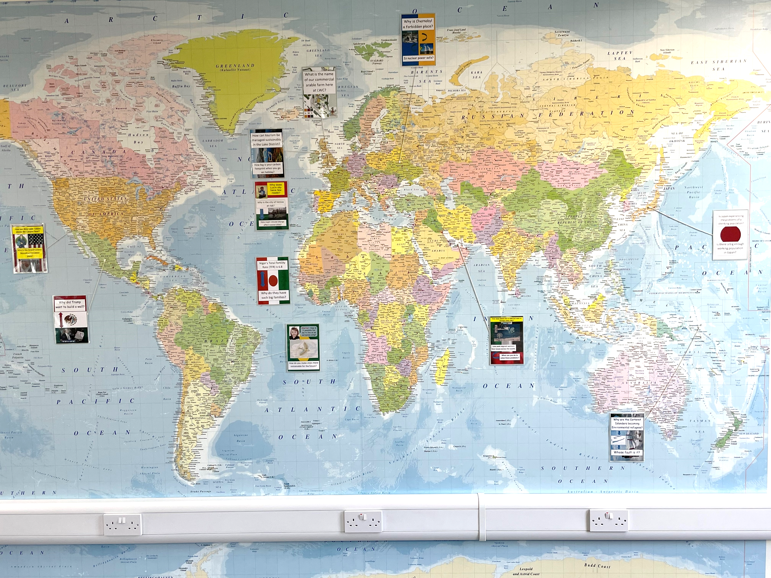
Geography asks us to be curious
Geography asks us to be curious about the world we live in, identify and interpret relationships.
Geography is the most popular optional subject at GCSE.
We have already started the GCSE content in 3rd Form giving us three years to develop and master the skills and knowledge of the 2-year GCSE course.
Geography offers a free of charge field trip to the south coast including Swanage or West Wittering.
Geography provides the soft skills of presentation, empathy, data analysis, tech-saviness and independent thought.
Exam skills are embedded already from 3rd Form enabling students to successfully answer GCSE level material.
Russel Group Universities see Geography as a preferred ‘facilitating’ subject. Geography itself can lead onto a wide range of university courses as well as careers ranging from town planning to volcanology.
All classes are taught by specialist teachers and Saturday morning clinics are available.

Slide 3
Geography examinations
We follow the Cambridge International Assessment Examination board. There are three papers to be sat at the end of 5th Form.
Paper 1 Physical and Human Geography accounts for 45% of the overall grade. We have already covered 5 of the 16 units in 3rd Form.
Paper 2 Map Skills accounts for 37.5% of the overall grade. This builds on the map work covered in 1st Form.
Paper 4 Alternative to Coursework accounts for 37.5% of the overall grade. This is based on the skills experienced on the free of charge compulsory field trip to Swanage or West Wittering.

Slide 4
Paper 1 Physical and Human Geography
The content is split across the following themes and units and accounts for 45% of the overall exam.
Theme 1 Human Geography
1.1 Population Dynamics
1.2 Migration
1.3 Population Structure
1.4 Population Distribution and Density
Theme 2 Physical Geography
2.1 Earthquakes and Volcanoes (Covered in 3rd Form)
2.2 Rivers (Covered in 3rd Form)
2.3 Coasts
2.4 Weather
2.5 Climate and Natural Vegetation
Theme 3 Economic Development Geography
3.1 Development
3.2 Food Production (Covered in 3rd Form)
3.3 Industry
3.4 Tourism (Covered in 3rd Form)
3.5 Energy (Covered in 3rd Form)
3.6 Water
3.7 Environmental Risk of Economic Development

Slide 5
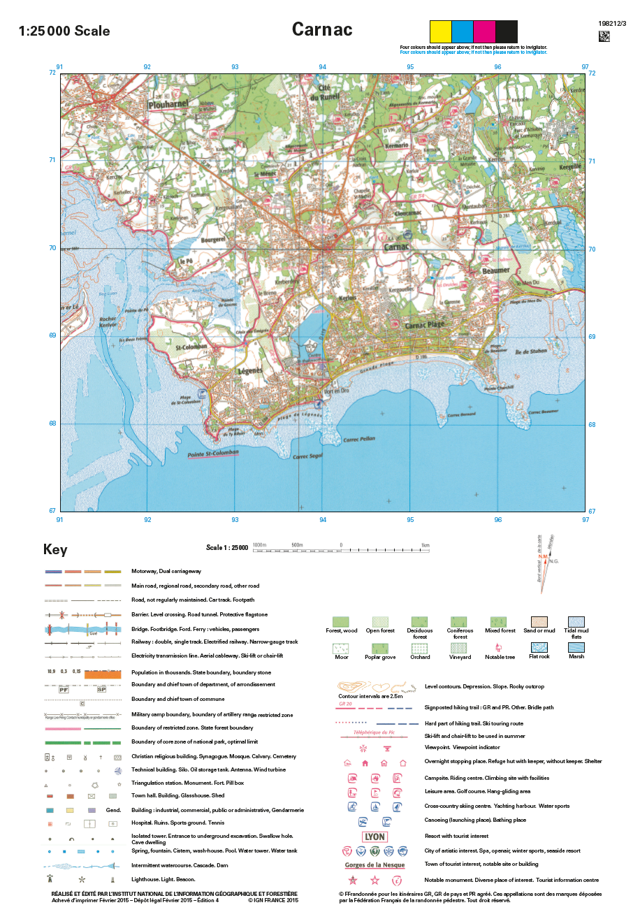
Paper 2 Map Skills
This paper looks at traditional map skills and asks students to be able to read the human and physical characteristics of a map as though they were actually there. This section accounts for 20 of the 60 marks.
Other skills are examined including ways of presenting data such as maps, diagrams, graphs, tables of data and written material. Content will be based on the units covered in Paper 1 and account for 40 of the 60 marks.
This paper accounts for 37.5% of the overall exam.

Slide 6
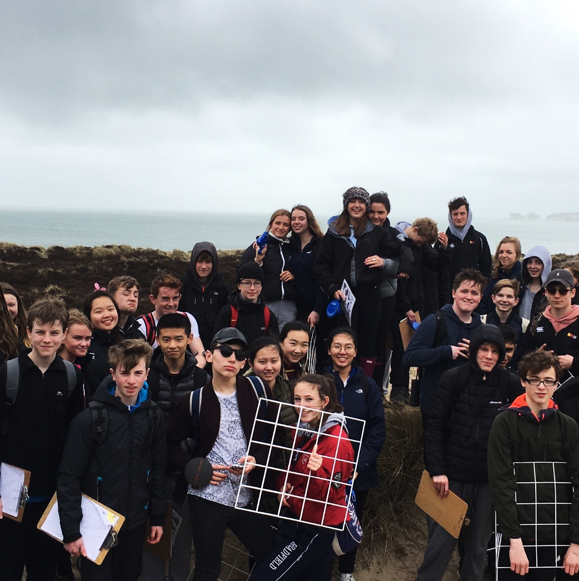
Paper 4 Alternative to Coursework
This paper replaces the traditional Paper 3 Coursework Project. Students practise a series of skills on their compulsory free of charge trip to the south coast either at Swanage or West Wittering. Students are given fieldwork data for a project based on one of the units covered in Paper 1. Here students are tested on a series of tasks including the elements of a project. These include:
Formulate aims and hypothesis
Outline how data may be collected during an investigation
Plot data or complete graphs of data
Describe the patterns in the statistics or graphs provided
Explain the meaning of graphs using your geographical understanding
Write a conclusion to a theoretical investigation
Evaluate the data collection methods used in the investigation
This paper accounts for 37.5% of the overall exam.

