Slide 1
Drama
Creative

Slide 2
Drama- What you will study…
Topics- Skills-
Script work skills- Mark Wheeller plays. Group work
Devising skills. Performance- voice & movement.
Exploring a play text. Interpreting scripts.
Improvisation skills. Evaluation skills.
Monologue/Duologue skills.
Each topic will give you a flavour of what GCSE Drama will be like. Lessons remain practical with elements of using One Note for learning.
Be Creative!

Slide 3
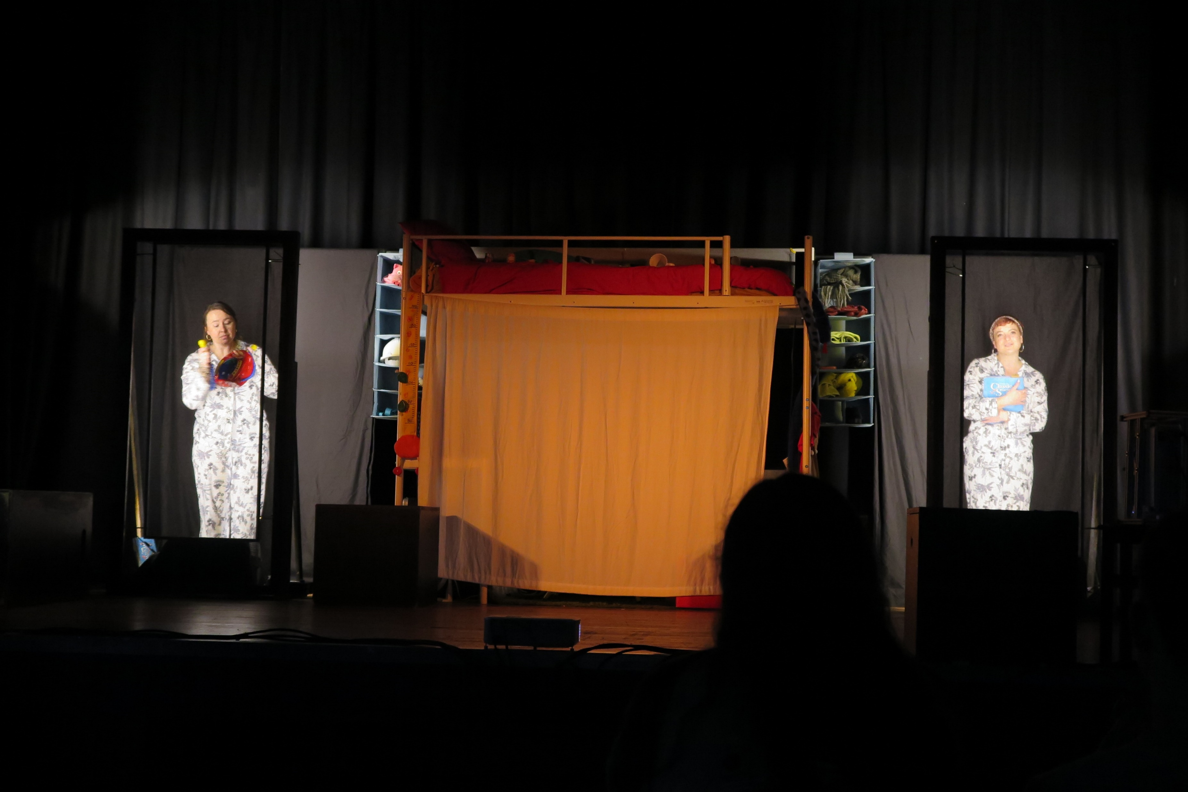
Watching live theatre.
You will have the chance to watch live theatre performance.
Last year ‘The Paper Birds’ Theatre company came to LWC and performed for 3rd form students exclusively.

Slide 4
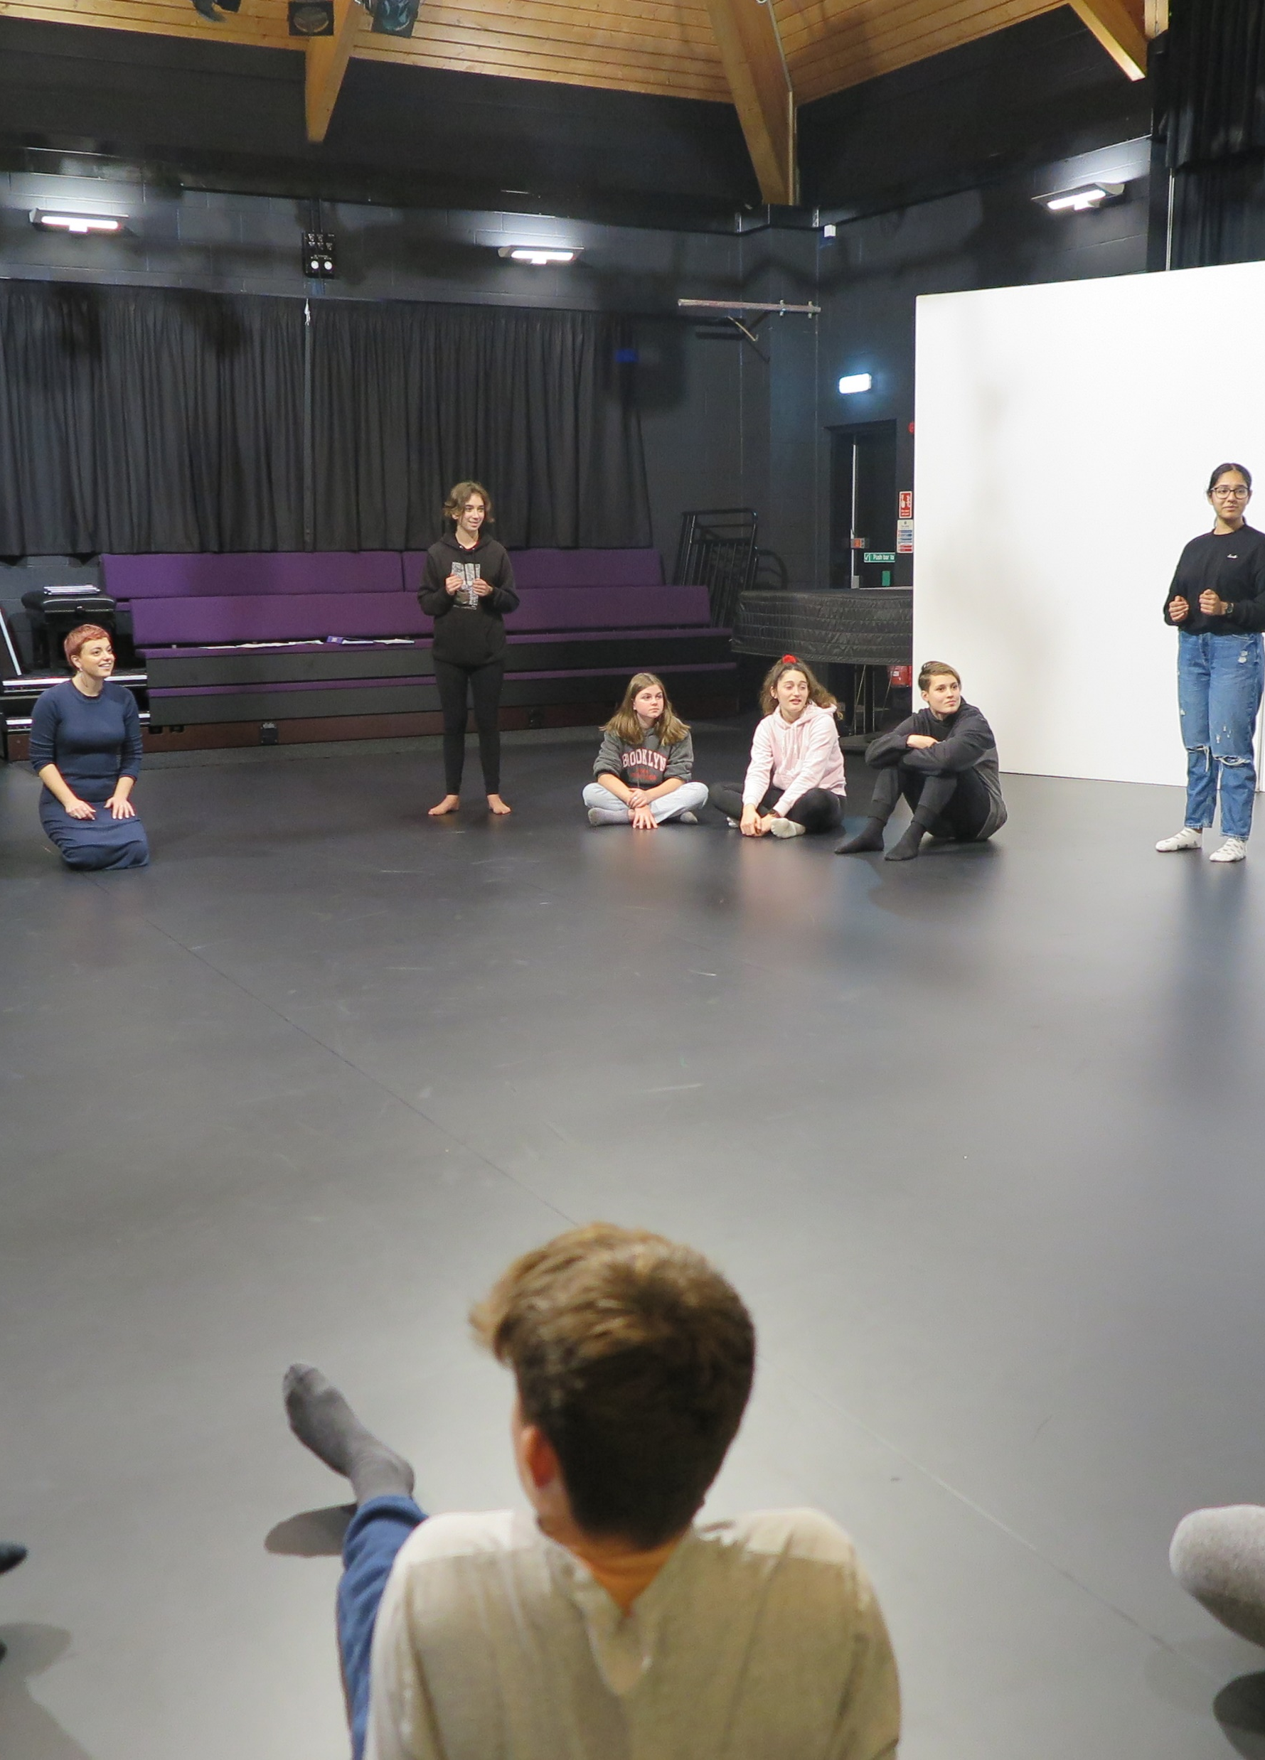
Drama workshops.
All 3rd form students will have the opportunity to be involved in a theatre workshop led by a professional acting company. A super exciting opportunity to develop skills.

Slide 5
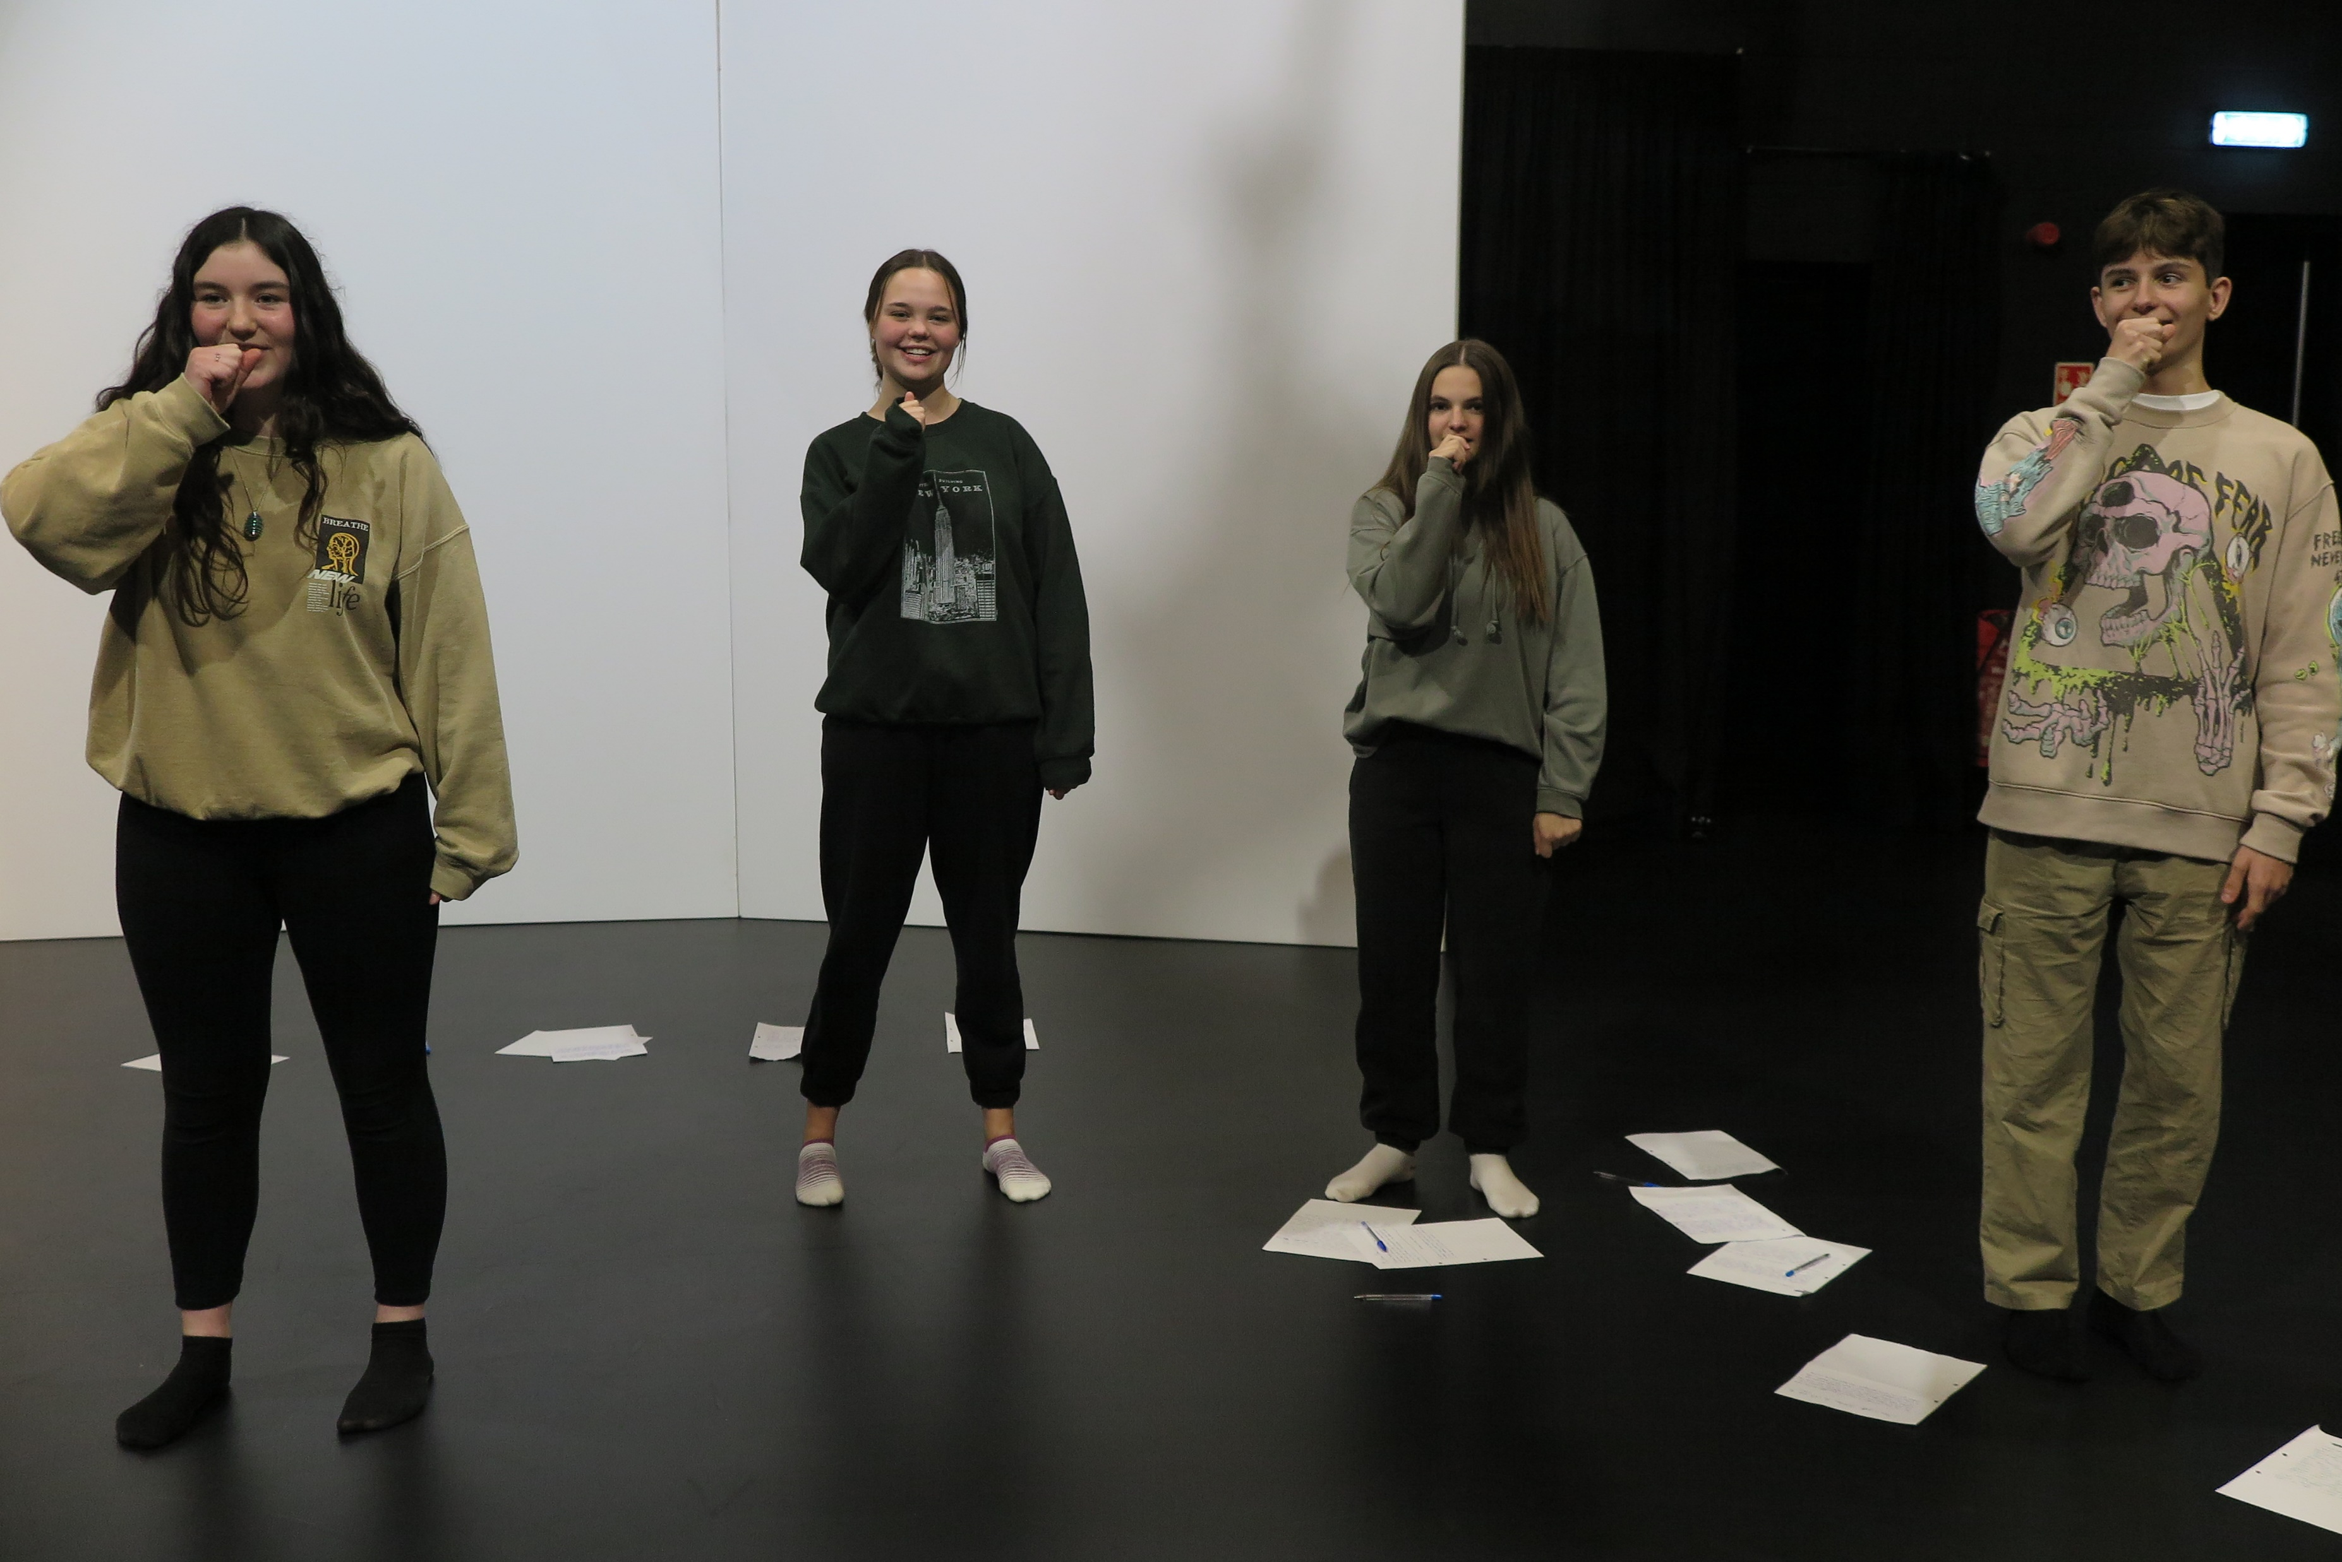
Why choose Drama?
A fantastic creative subject that will allow you to develop your confidence and communication skills. These skills can be transferred across many subject areas and into your future careers.
If you enjoy performing and wish to continue developing your skills, Drama is the subject for you!

