Slide 1
Computer Science
3rd Form - Communicating information Creatively

Slide 2
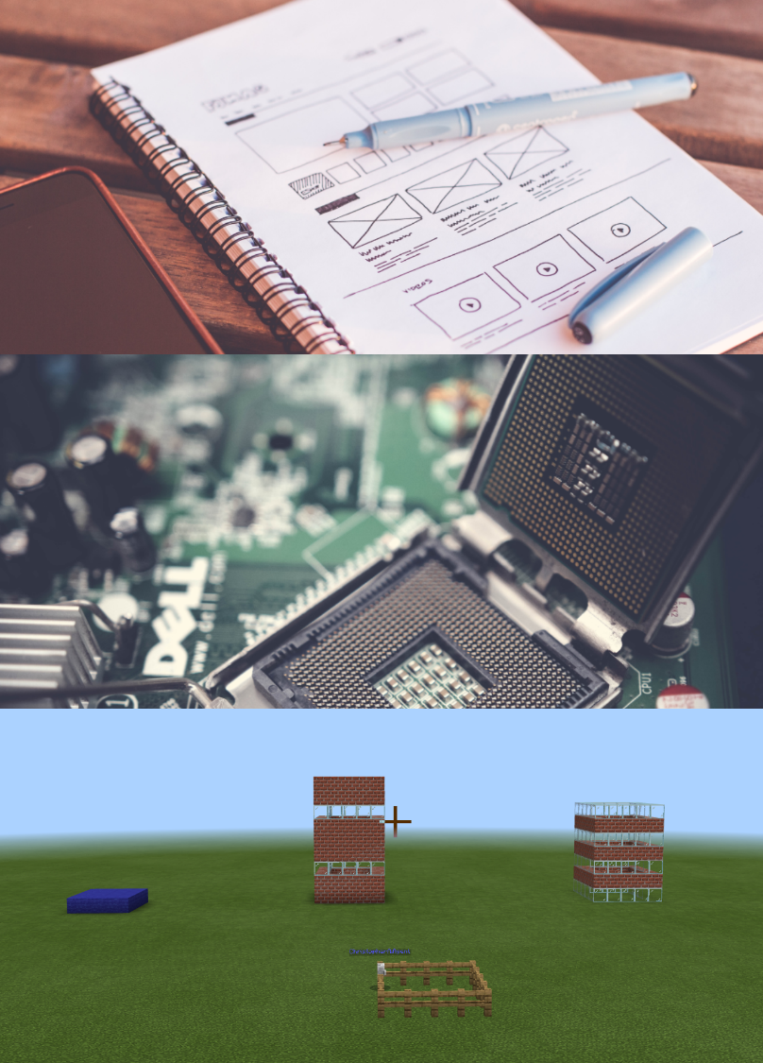
Year overview
3rd Form
The 3rd Form Computer Science course focuses on the key skills of collaboration, communication and creativity.
We focus on three sections of work during the 3rd Form at Lord Wandsworth College. We complete a full web design project, a series of modules on key theoretical knowledge to build a foundation for the GCSE and the use of programming concepts within Minecraft.

Slide 3

Communicating Information - Web Design
Web Design
This section introduces students to the foundations of web development using HTML, CSS and JavaScript before allowing students the opportunity to develop their own website.
The summative assessment for this section looks at the full project development cycle.
Students are encouraged to place equal amounts of importance on research, analysis, design and evaluation, as well as the actual development of the website.

Slide 4

Communicating Information – Theory
Theory Topics
Students cover a range of modules looking at topics such as System Security, Hardware and Binary Representation.
Work in these modules is assessed by using paper based assessments in the same way as GCSE students (+2).
The expectation of the classwork is that students will develop their theory into a website, developing the work of the previous section, rather than working solely in OneNote.

Slide 5
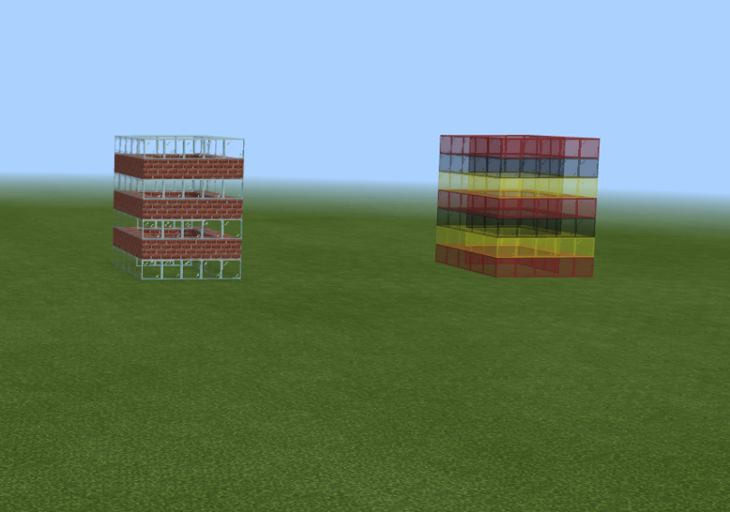
Collaborative development - Minecraft
Minecraft
Students use the popular Minecraft Education to understand key programming concepts such as sequence, iteration and methods.
Students will develop their JavaScript skills inside Minecraft, making the agent build structures programmatically.
The expectation is that students will design and program their own large and detailed structures and collaborate with other students in their group.

